Slide 1

Group 5 - Using Machine Learning Models to Predict Depression States
Our goals
Project management
The “DEPRESJON” dataset
Literature that influenced us
Our models and results
Our final thoughts
Notes:
Time: 0:30
Total: 0:30
Team Member1: "Hello, we are Group 5, and our project focused on using machine learning models to predict depression states.“
Team Member2: "Today, we'll walk you through our working practices, delve into the Depression Dataset we utilised, highlight key literature that shaped our models, and explain the process of assembling our models and the rationale behind our decisions.“
Team Member3: "Additionally, we'll start and conclude with reflections on our personal goals and insights gained from the project."

Slide 2
Our goals
Daryne Bouadi: I aim to build a better understanding in analysing and interpreting data as well as leaning more about machine learning and big data.
Deniz Turan: My primary objective is to deepen my understanding of various machine learning algorithms and explore the deep learning models in general. Additionally, I aim to sharpen my skills in collaborating with a team, with a goal of successfully delivering end-to-end project.
Petter Lövehagen: My mission is to fully engage with the team, contributing to our collective growth in machine learning competency and professional collaboration abilities. I look forward to learning from my peers and tutors to advance my own skills, knowledge, and ways of working, as well as producing high-quality deliverables.
Tom Grubb: I wish to learn more about different machine learning models and apply them in a real-life context. I am interested to learn more about model transparency. I am looking forward to working with my group and exploring different strategies that may improve our teamwork.
Yacine Ramdani: My mission is to absorb knowledge and hone my skills across various machine learning technologies, preparing myself to seamlessly apply them in real-world contexts.
Notes:
Time: 1:00 Minute (10 seconds each)
Total: 1:30
Team Member4: “Before we started the project we set out some personal goals for ourselves that we included in our project proposal. As we introduce ourselves to you we will also go through briefly what we wanted to gain from the project”
Daryne: “Hello I am Daryne …
Deniz:
Petter: My name is Petter. I am a part-time student, working full-time – sometimes feels the other way round. For this project, I wanted to gain more overall data science experience, share my experience and learn from teammates.
Tom : “Hello I am Tom, as I am retraining and new to coding this year I wanted to enhance my python skills as well as learning different ways to manage group data projects.”
Yacine:

Slide 3
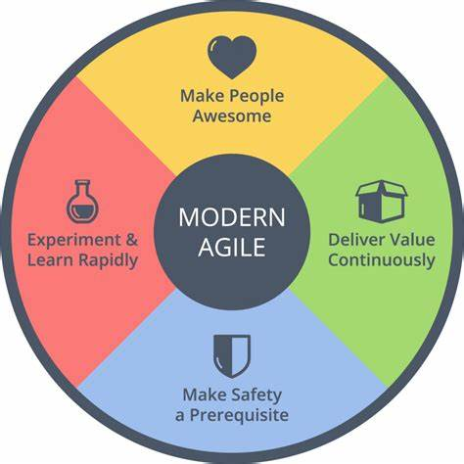
Agile working practices
Regular Meetings
Breaking the project into smaller, manageable tasks.
Frequently integrating code changes into a shared repository.
Planning sessions at the beginning of each weekly meeting to define goals, tasks, and priorities.
Time used for Reflections on what went well, what didn't, and how to improve.
Notes:
Time: 0:30
Total: 2:00
Team Member 5: “When we started the project, we all agreed we wanted to work in an “Agile” manner – that is iterative, focusing on the code, reflecting on what worked well and what didn’t and rapidly adapting”

Slide 4
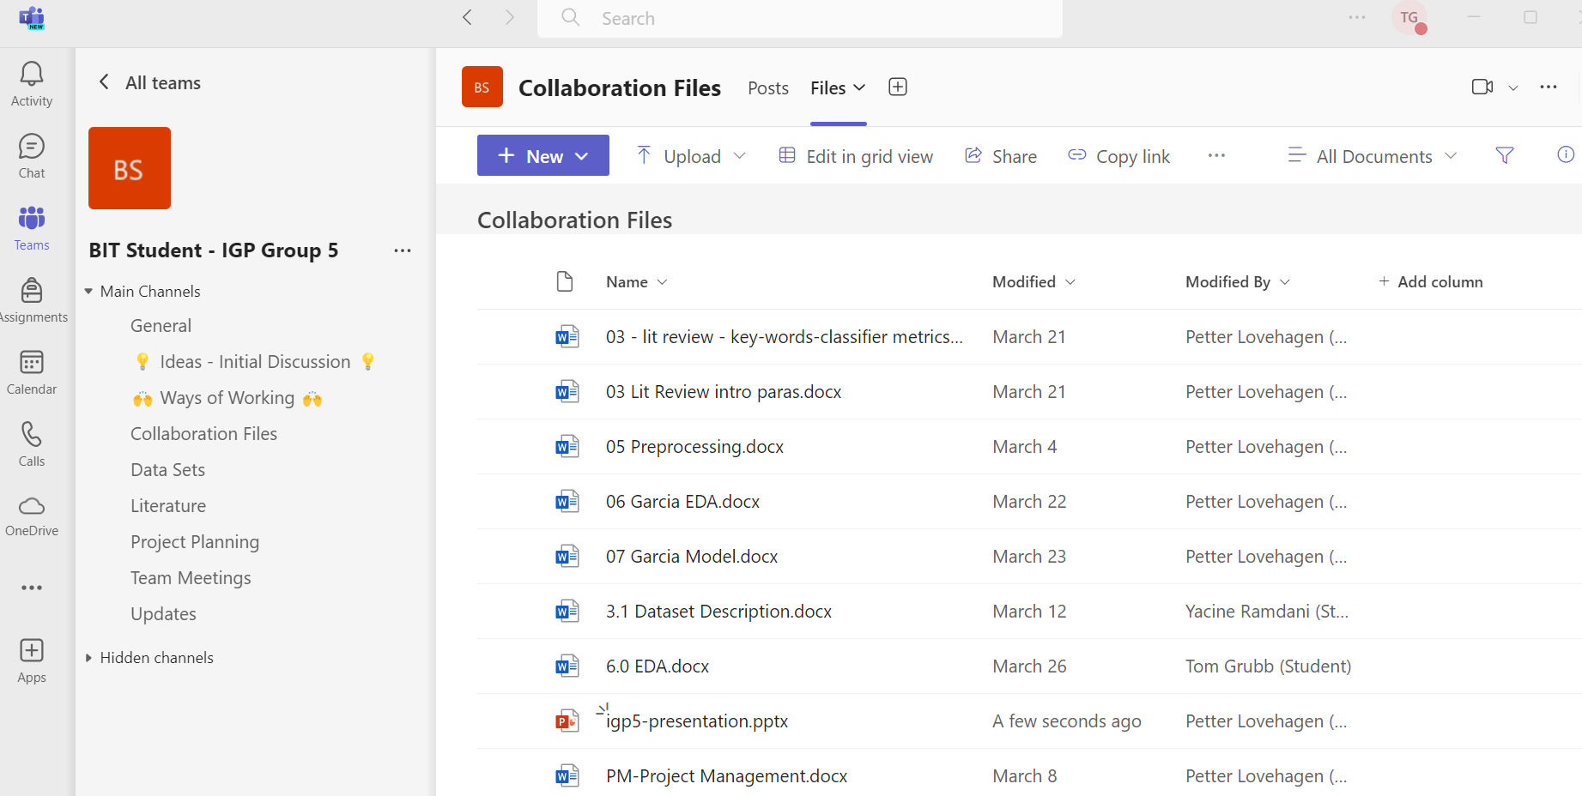
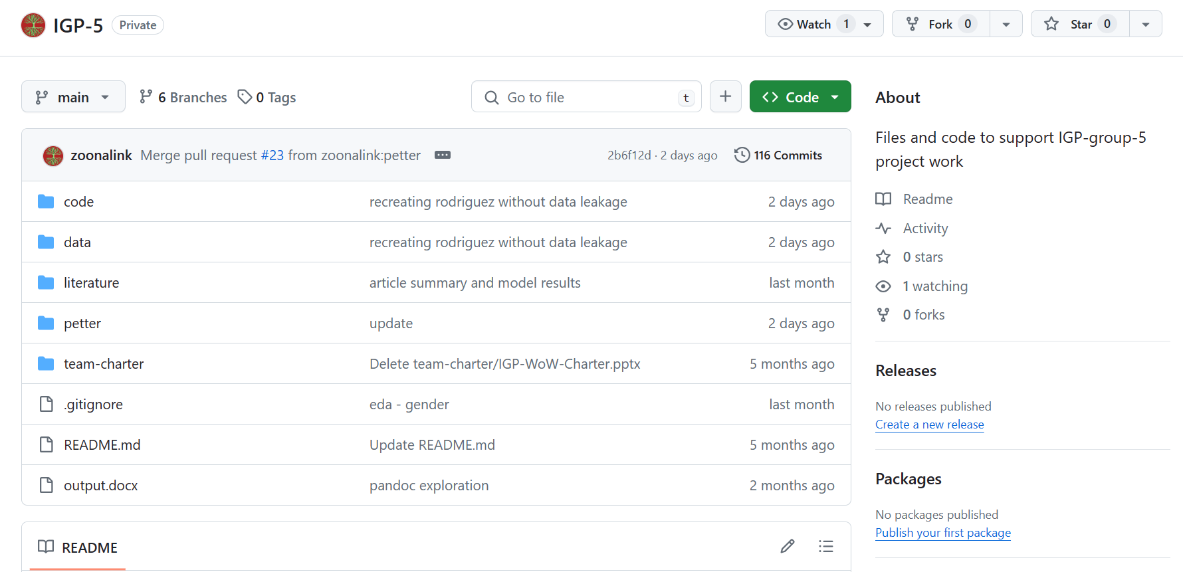
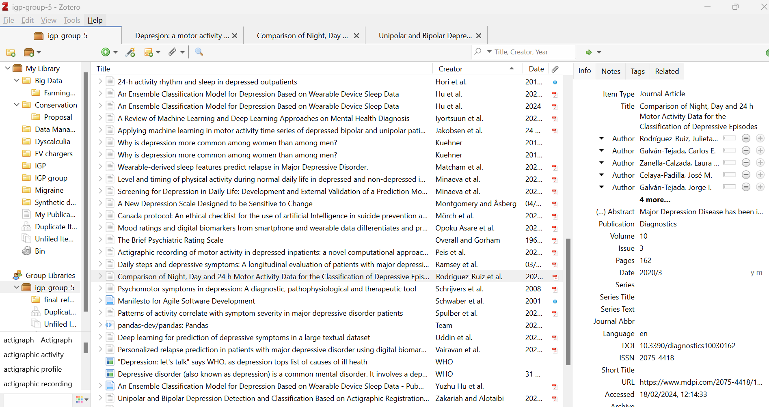
Project Management Tools
Teams Microsoft Suite
GitHub
Zotero
Teams used to facilitate our online meetings and for file storage.
Word, Excel and PowerPoint also used.
Version Control, Coding and Markdown repository.
Managing and storing our references.
Notes:
Time: 0:30
Total: 2:30
Team Member 3: “We used a number of digital tools that supported a dynamic way of working, allowing team members to work in parallel with each other while at the same time working toward a joint end goal”
Here are some of the tools we used in our day to day working practice.
Teams was used to share our Microsoft files, which included our meeting minutes. It was also a means to meet online, which was especially useful to those that were unable to attend meetings in person.
Github was the way we shared and version controlled our code and markdown files
Zotero was used to manage our references.
Time: 0:30 Minute
Total: 1:30
TODO: Tidy animation, zotero

Slide 5
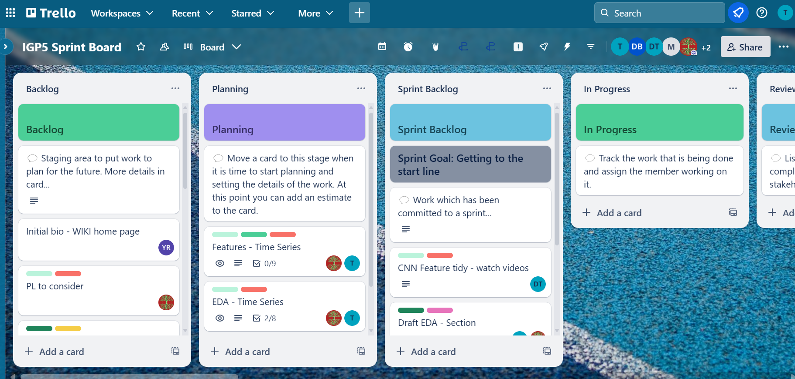
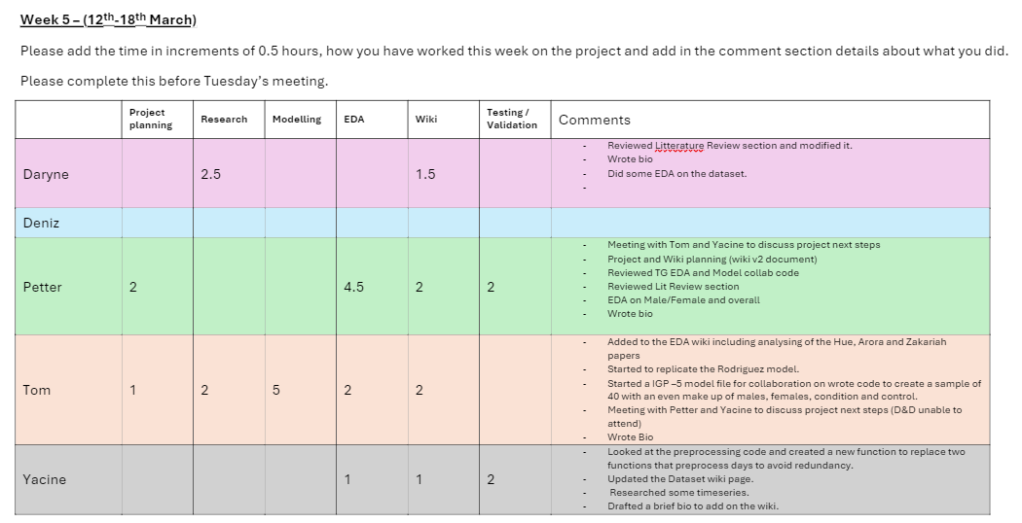
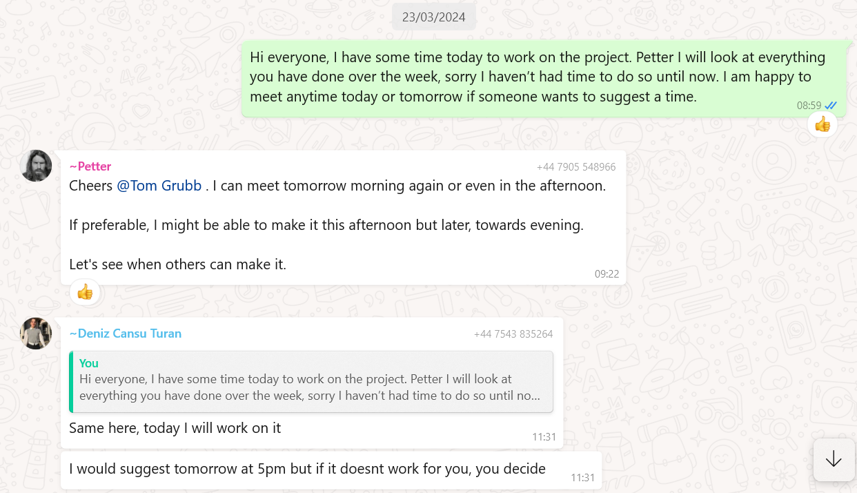
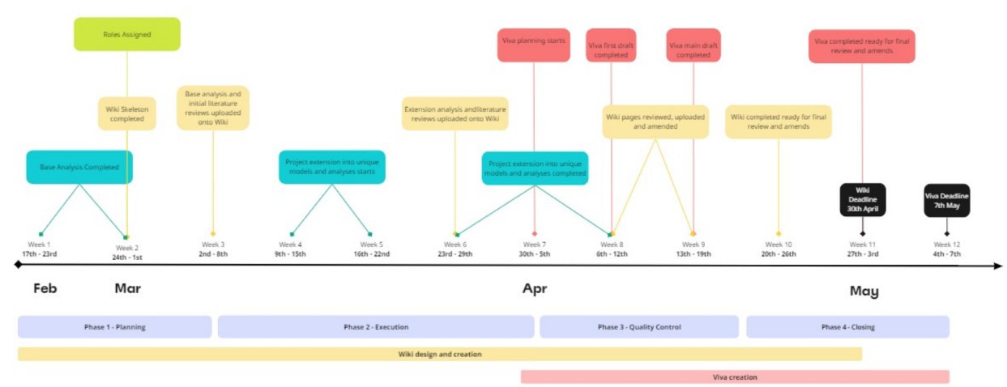
Project Management Tools
Trello
Activity Logs
WhatsApp
Miro
Kanban board used to manage to do lists and planning. Was a key feature of our earlier meeting structure.
Used as a replacement for Trello to keep a record of member contributions.
Used for general communication and some simple file sharing.
Used to create timelines and other visuals
Notes:
Time: 0:30
Total: 3:00
Team Member 4: “As well as those:
Trello was used to structure our initial weekly meetings and used by members to plan their weekly tasks. Later in the project the group found that Trello added an extra level of admin taking up valuable meeting time and this meant that we abandoned its use replacing it with a weekly time log shared in teams, this was also abandoned for similar reasons and a simple to do list was adopted at the end of the project.
Whatsapp was our primary communication tool. We used this to arrange meetings, update members that missed meetings and share ideas throughout the week.
Miro was used to create timelines and other visuals.
Now – on to our project…
TODO: Tidy animation,

Slide 6

Depression
At least 350 million people live with depression - it is the leading cause of disability worldwide
More than 700 000 people die due to suicide every year
According to the Center for Disease Control (CDC), depression causes an estimated 200 million lost workdays each year at the cost of $17 billion to $44 billion to employers.
Notes:
Time: 0:30
Total: 3:30
Team member ?: “Depression afflicts over 350 million people worldwide, profoundly impacting lives and livelihoods.
It results in more than 700 thousand suicides and impacting millions of families and friends.
According to the CDC, depression causes 200 million lost workdays in the United States. And these figures are sadly on the rise.
With this as the background, our goal in this project is to explore and advance efforts using machine learning for early detection of depression states in order to assist diagnosis and treatment of this devastating condition.”

Slide 7

The “DEPRESJON” Dataset
The dataset was originally collected in Norway to study motor activity in schizophrenia and major depression.
Motor activity was recorded in 1-minute intervals by actigraphy watches worn at the right wrist.
Berle, J.O., Hauge, E.R., Oedegaard, K.J., Holsten, F. and Fasmer, O.B. (2010) Actigraphic registration of motor activity reveals a more structured behavioural pattern in schizophrenia than in major depression. BMC Research Notes [online]. 3 (1), p. 149. Available from: https://bmcresnotes.biomedcentral.com/articles/10.1186/1756-0500-3-149 [Accessed 9 April 2024].
Garcia-Ceja, E., Riegler, M., Jakobsen, P., Tørresen, J., Nordgreen, T., Oedegaard, K.J. and Fasmer, O.B. (2018) Depresjon: a motor activity database of depression episodes in unipolar and bipolar patients. In: Proceedings of the 9th ACM Multimedia Systems Conference [online]MMSys ’18: 9th ACM Multimedia Systems Conference. Amsterdam Netherlands: ACM, pp. 472–477. Available from: https://dl.acm.org/doi/10.1145/3204949.3208125 [Accessed 2 December 2023].
Notes:
Time: 0:30
Total: 4:00
Team Member 5: “The depression dataset consists of 3 csv files, two files containing activity data called “condition and control” measured by actigraph watches and one file called “scores” containing background information about the participants. The data was collected in Norway hence the title of the dataset which is the Norwegian spelling of depression ‘Depresjon’ ”

Slide 8
The “DEPRESJON” Dataset
Total Participants: 55
Diagnosed Depression: 23 participants
(labelled condition)
Control Group: 32 participants
(labelled condition)
Gender Distribution:
Male: 25
Female: 25
 | Male | Female | Total
Condition | 13 | 10 | 23
Control | 12 | 20 | 32
Total | 25 | 30 | 55
Garcia-Ceja, E., Riegler, M., Jakobsen, P., Tørresen, J., Nordgreen, T., Oedegaard, K.J. and Fasmer, O.B. (2018) Depresjon: a motor activity database of depression episodes in unipolar and bipolar patients. In: Proceedings of the 9th ACM Multimedia Systems Conference [online]MMSys ’18: 9th ACM Multimedia Systems Conference. Amsterdam Netherlands: ACM, pp. 472–477. Available from: https://dl.acm.org/doi/10.1145/3204949.3208125 [Accessed 2 December 2023].
Notes:
Time: 0:30
Total: 4:30
Team Member 1: “There were 55 participants in total where 23 were diagnosed with depression and 32 were a control. The study contained more females than males in total but there were more males in the condition group than female.”

Slide 9
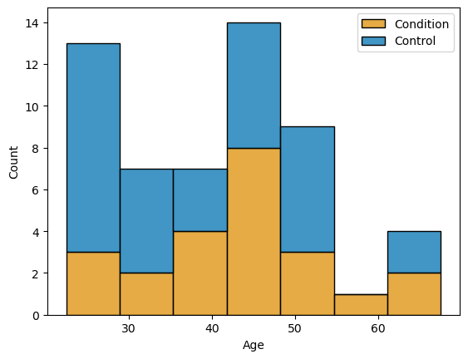
The “DEPRESJON” Dataset
The data set is made up of a diverse age range with all participants being between the ages of 20 and 69
Garcia-Ceja, E., Riegler, M., Jakobsen, P., Tørresen, J., Nordgreen, T., Oedegaard, K.J. and Fasmer, O.B. (2018) Depresjon: a motor activity database of depression episodes in unipolar and bipolar patients. In: Proceedings of the 9th ACM Multimedia Systems Conference [online]MMSys ’18: 9th ACM Multimedia Systems Conference. Amsterdam Netherlands: ACM, pp. 472–477. Available from: https://dl.acm.org/doi/10.1145/3204949.3208125 [Accessed 2 December 2023].
Notes:
Time: 0:00
Total: 4:30
Team Member 2: “The distribution of the ages of the participants in the study is relatively symmetrical with most participants in their 40s. The control group has the majority of their extra participants in their 20s”

Slide 10
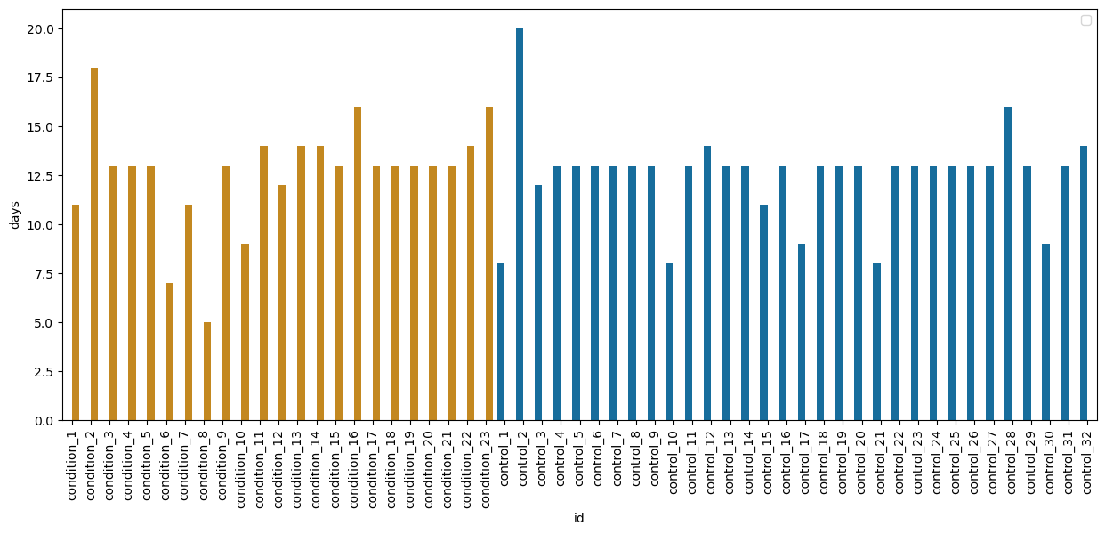
Dataset Limitations
Different number of days
Some unreliable readings
Missing information about the control group
Missing key health information
Garcia-Ceja, E., Riegler, M., Jakobsen, P., Tørresen, J., Nordgreen, T., Oedegaard, K.J. and Fasmer, O.B. (2018) Depresjon: a motor activity database of depression episodes in unipolar and bipolar patients. In: Proceedings of the 9th ACM Multimedia Systems Conference [online]MMSys ’18: 9th ACM Multimedia Systems Conference. Amsterdam Netherlands: ACM, pp. 472–477. Available from: https://dl.acm.org/doi/10.1145/3204949.3208125 [Accessed 2 December 2023].
Notes:
Time: 1:00
Total: 5:30
Team Member 3: “There are number of limitations / observations to the data set to acknowledge.
Firstly each participant does not have a consistent number of days of activity data as shown by the chart.
Secondly there is an issue with the reliability of some of the actigraphy readings, in one case in particular the data collected shows that the participant’s actigraph watch was not generating reliable readings. It is advised that the data is cropped to remove all unreliable data.
Thirdly there is extra information provided describing each participant in the condition group, but this is not provided for the control such as marriage, employment and education levels. Which means that a lot of this information cannot be used in binary classification models.
Lastly in addition to little biodemographic details, the dataset lacks valuable information such as about the general lifestyle of the participants – baseline health, medication, physical activity levels, etc.
As the data generated is primarily motor activity data it is an oversight by those conducting the study that they did not include information about the general health of the participants which may be a cause of a reduction in day-to-day activity.
In short, it is a simple dataset with a small number of participants from a specific part of the world. A question might be – how well does this generalise to global populations?

Slide 11
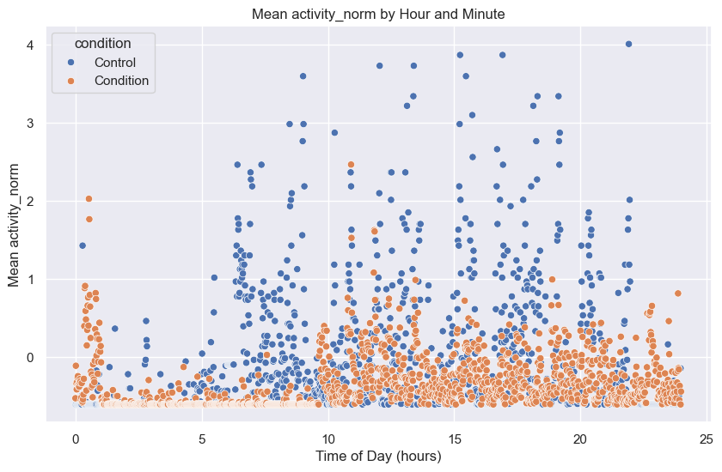
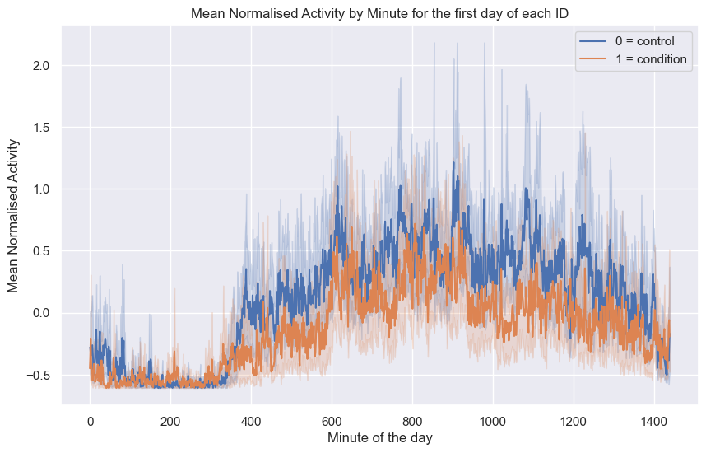
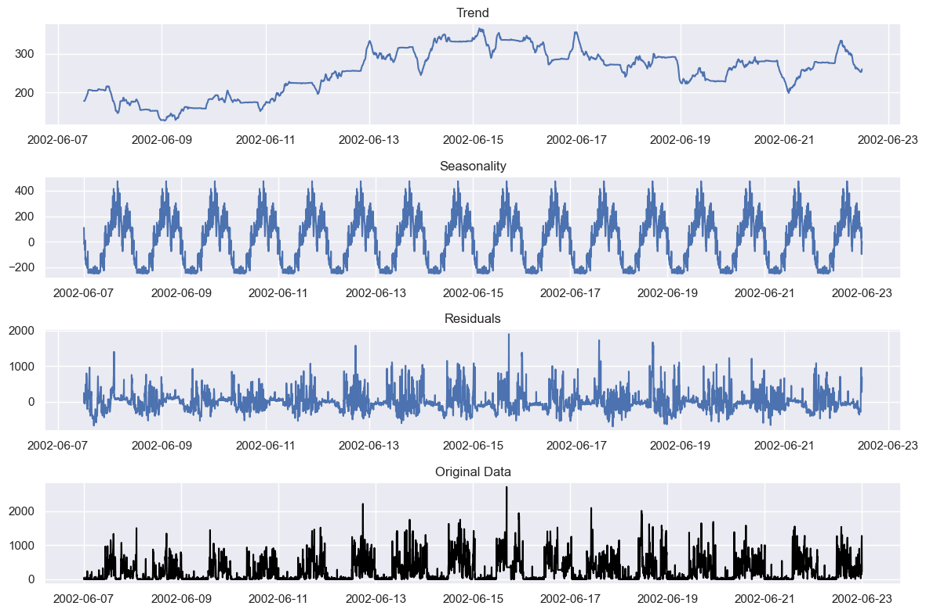
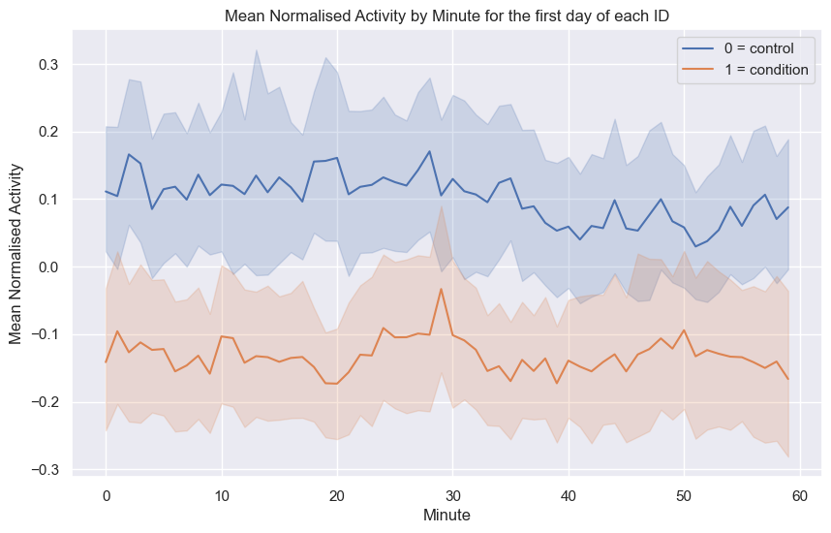
Working with Time Series
Notes:
Time: 0:30
Total: 6:00
Team Member ?: We wanted to very briefly acknowledge that we are working with time series data which comes with its own properties and challenges. In the interest of time limitations, we will not go into detail, only to say that our investigations led us to explore varies aspects including temporal patterns, decomposition, looking at autocorrelation and spectral analysis – in particular when it came to feature engineering, as will see later in the presentation.
Here are some examples of working with time series including:
* Looking at different time frequencies (minute, hour, daily), rolling averages, seasonal decomposition
control_17, condition_17 – mean of all Mondays days
Mean norm activity for all first days
Every day for every person, by minute
Seasonal decomposition
Temporal patterns – example sleep-wake cycles
Techniques:
Decomposition – separating sleep from noise
Autocorrelation – correlations in sleep data
Spectral analysis – sleep frequency patterns
Uses:
Predicting sleep patterns
Forecasting depressive episodes
Helping diagnose severity
Challenges:
Data volume, complexity - hard to extract meaningful insight, computationally expensive
High dimensionality from feature engineering
Seasonality and trends – adjusting for variations
Individual variability
Missing data

Slide 12
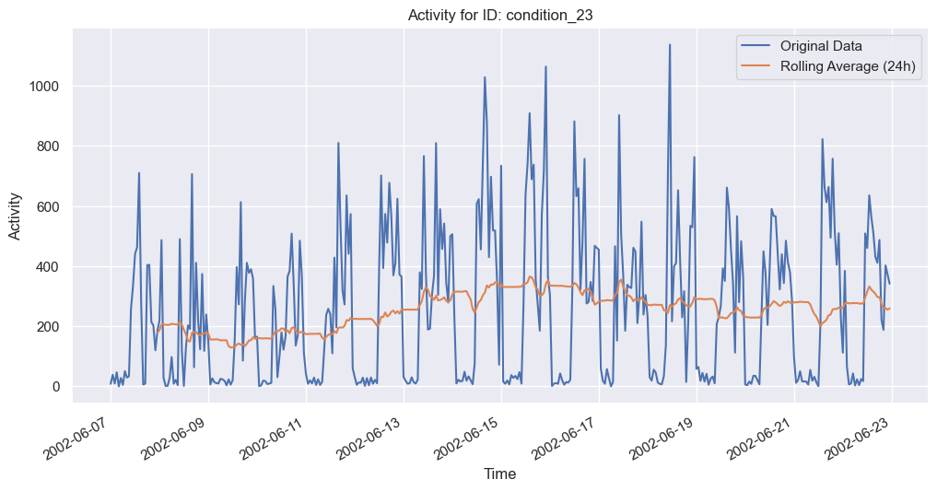
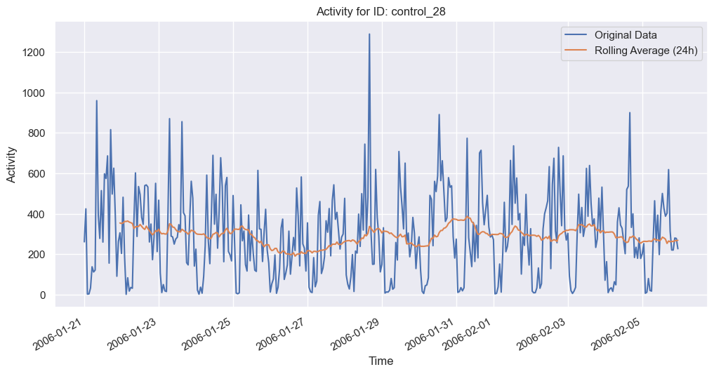
Rolling Averages
Condition_23
Contorl_28
Notes:
Time: 0:00
Total: 6:00
Team Member ?: Here we can see some of the challenges and opportunities of working with time series data – there are clear daily patterns but also potentially a significant amount of noise. So the challenge is to isolate the signal. There also appears to be a noticeable differences between the individuals.

Slide 13
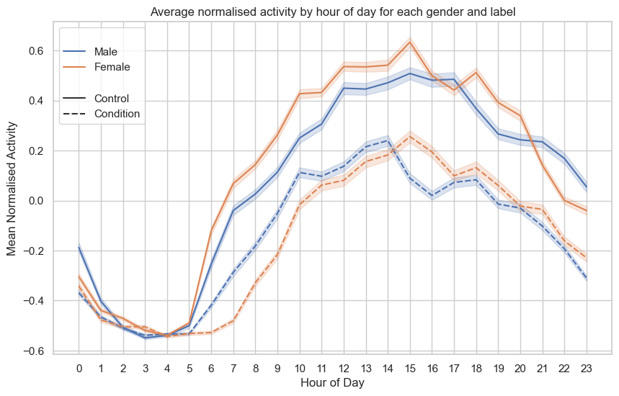
Research Question
Depression is about 50% more common among women than among men
Notes:
Time: 0:30
Total: 6:30
Team member ?: During our literature research and when performing EDA on the Depresjon dataset, we did not find any studies which looked specifically at the prediction of depression with gender-specific models.
This got us thinking that this could be an interesting angle to explore as we had gender for all 55 people in the dataset. Here is some initial EDA which suggests that it could be worthwhile investigating.
We know that men and women experience depression differently, at different times in their lives, at different frequencies. We also know intuitively that men and women most likely have differences in terms of actigraphy profiles due to any number of reasons. So we formulated this as our research question:
Is it worth exploring gender-specific models for predicting depression states from actigraphy data?

Slide 14
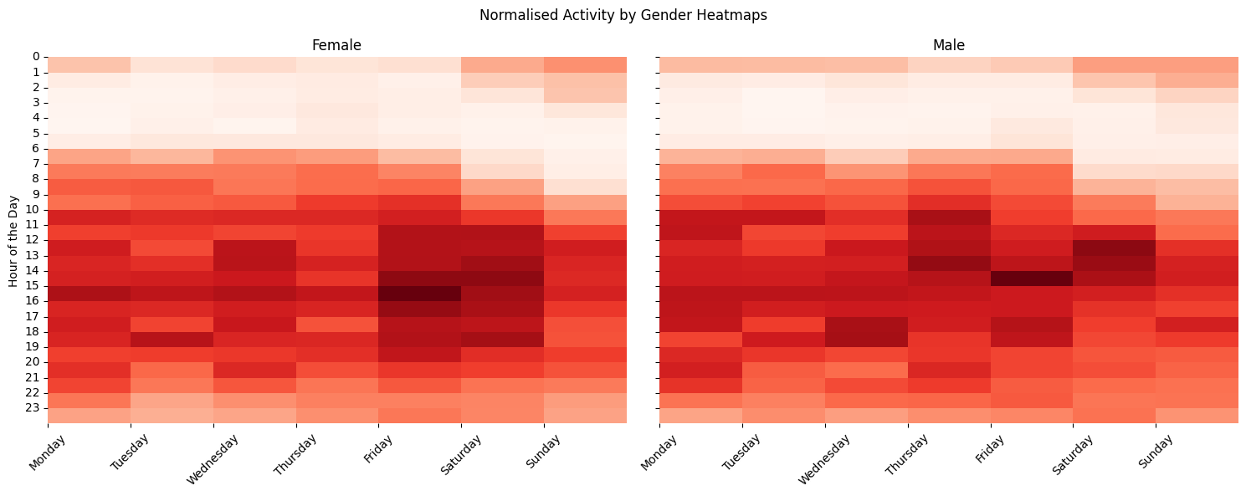
Research Question
Exploring gender-specific models for predicting depression states from actigraphy data
Notes:
Time: 0:30
Total: 6:30
Team member ?: During our literature research and when performing EDA on the Depresjon dataset, we did not find any studies which looked specifically at the prediction of depression with gender-specific models.
This got us thinking that this could be an interesting angle to explore as we had gender for all 55 people in the dataset. Here is some initial EDA which suggests that it could be worthwhile investigating.
We know that men and women experience depression differently, at different times in their lives, at different frequencies. We also know intuitively that men and women most likely have differences in terms of actigraphy profiles due to any number of reasons. So we formulated this as our research question:
Is it worth exploring gender-specific models for predicting depression states from actigraphy data?

Slide 15
Garcia et al.
What methods can we use?
Preprocessing
Use full days
Match the number of days in the score dataset with the activity data
Features Extracted
Standard measures used: mean / std
Zero % measure
Normalised values
Garcia-Ceja, E., Riegler, M., Jakobsen, P., Tørresen, J., Nordgreen, T., Oedegaard, K.J. and Fasmer, O.B. (2018) Depresjon: a motor activity database of depression episodes in unipolar and bipolar patients. In: Proceedings of the 9th ACM Multimedia Systems Conference [online]MMSys ’18: 9th ACM Multimedia Systems Conference. Amsterdam Netherlands: ACM, pp. 472–477. Available from: https://dl.acm.org/doi/10.1145/3204949.3208125 [Accessed 2 December 2023].
15
Notes:
Time: 0:30
Total: 7:00
Team Member 4: “There are numerous models and studies which we looked at and recreated before we created our own models. We decided to focus on a choice few which we found interesting and picked out several features that we wished to bring into our model. We also identified aspects of the projects that we should avoid.
Team Member 5: “The Garcia model was the initial study and laid benchmark figures that we could use to help compare the success of our model against. There were a number of approaches that we could use in our model.
Team Member 1: In preprocessing we would reduce each participants’ data to only hold full days and match the number of days of activity data to the value given in the scores data set.
The features used in the study were the mean, standard deviation and the percentage of zero activity, all these values were normalised. In studying these features in our EDA we saw that there lay potential in their use in a classification model.

Slide 16
Garcia et al.
What methods can we use?
Models Used
Nearest Neighbour
Linear SVM
RBF SVM
Gaussian Process
Decision Tree
Random Forest
Neural Net
AdaBoost
Naïve Bayes
QDA
ZeroR baseline
Evaluation Metrics
Precision
Recall
Accuracy
Specificity
Matthews Correlation Coefficient
F1-Score
Garcia-Ceja, E., Riegler, M., Jakobsen, P., Tørresen, J., Nordgreen, T., Oedegaard, K.J. and Fasmer, O.B. (2018) Depresjon: a motor activity database of depression episodes in unipolar and bipolar patients. In: Proceedings of the 9th ACM Multimedia Systems Conference [online]MMSys ’18: 9th ACM Multimedia Systems Conference. Amsterdam Netherlands: ACM, pp. 472–477. Available from: https://dl.acm.org/doi/10.1145/3204949.3208125 [Accessed 2 December 2023].
16
Notes:
Time: 0:30
Total: 7:30
Team Member 2: “The study didn’t focus on one modelling technique and instead used many comparing their results. This was an approach replicated by other studies and so we thought we should also use a similar approach. The metrics used to evaluate the models were also numerous and used in other studies we noticed that the MCC value for each model was relatively low (~0.4), hopefully we would be able to generate models with higher metrics.

Slide 17
Garcia et al.
What didn’t make sense to us.
Hour by hour measures.
A lack of description in what was being classified.
Garcia-Ceja, E., Riegler, M., Jakobsen, P., Tørresen, J., Nordgreen, T., Oedegaard, K.J. and Fasmer, O.B. (2018) Depresjon: a motor activity database of depression episodes in unipolar and bipolar patients. In: Proceedings of the 9th ACM Multimedia Systems Conference [online]MMSys ’18: 9th ACM Multimedia Systems Conference. Amsterdam Netherlands: ACM, pp. 472–477. Available from: https://dl.acm.org/doi/10.1145/3204949.3208125 [Accessed 2 December 2023].
17
Notes:
Time: 0:30
Total: 8:00
Team Member 3: “There were approaches used in the study which we didn’t agree with. The major issue was that the features were compiled for every hour. This made meant that the model produced was classifying every hour as depressed or non-depressed rather than the participants. Although we accepted that these method produced more data to help train the models and potentially could classify an hour of activity data we felt that hourly data did not capture enough information about each participants activity and so we decided to compile our data into 24 hour periods instead.
@tom – I am not sure about this slide. My main observation is that it wasn’t clear what they did. The results are most likely based on days (independent of the individual) – so looking at the charts, there are 402 ‘normal’ days and 291 ‘depressed’ days. Presumably their models are based on predicting whether a day belongs to a depressed person or not. This is reasonable to me, but it needs more discussion and transparency. They could have used hourly features and then aggregated to day-prediction, but it is not clear.

Slide 18
Rodriguez et al.
What methods can we use?
Preprocessing
Split the data into day night periods.
Features Extracted
Study identified that kurtosis was a key classifying feature.
18
Notes:
Time: 0:30
Total: 8:30
Team Member 2: “The Rodriguez project was intriguing for 2 reasons, firstly they split the data into day and night, two periods where motor activity features would be potentially very different, we felt that features based on this would be interesting to investigate although we used an improved version based on the Hu et al. project. Also, they identified that kurtosis was a feature that gave them great results, in fact the study claims accuracy results of 99.72%. We felt that this was incredibly suspicious and wanted to investigate the legitimacy of these results.

Slide 19
Rodriguez et al.
Many things to avoid.
Data leakage
Variable collinearity
Kaggle mentality (Get the best accuracy at all costs)
19
Notes:
Time: 0:30
Total: 9:00
Team Member 3: “The greatest benefit of studying the Rodriguez model is we learnt a lot about what not to do. There were two major reasons for the incredibly high accuracy, firstly that there was a complete disregard for potential data leakage and secondly the study used a large number of similar features that would have been high correlated. We saw this sort of “Kaggle mentality” in other studies where there was a disregard for proper methods in order to achieve the highest possible accuracy scores.

Slide 20
Frogner et al.
Jakobsen et al.
Espino-Salinas et al.
Investigate ideal segment length for the detection of depression
1D-CNNs
10 epochs with a batch size of 16 and a learning rate of 0.001 using the Adam optimizer.
3-fold cross-validation to avoid overfitting
Mean F1-score of 0.70
Using ReLU activation functions, Softmax activation function in the final layer.
Consists of two fully connected hidden layers
2D-CNN

Slide 21
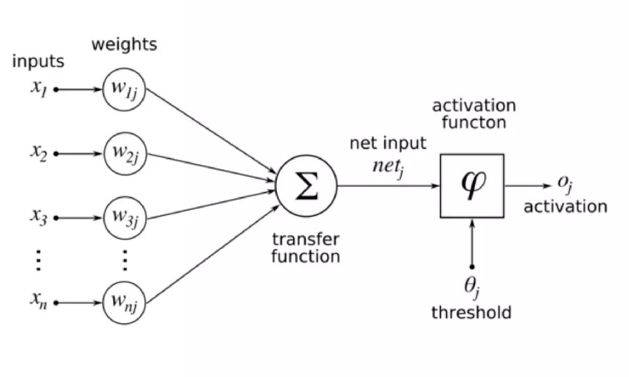
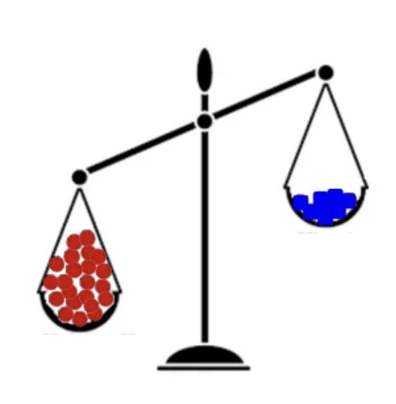
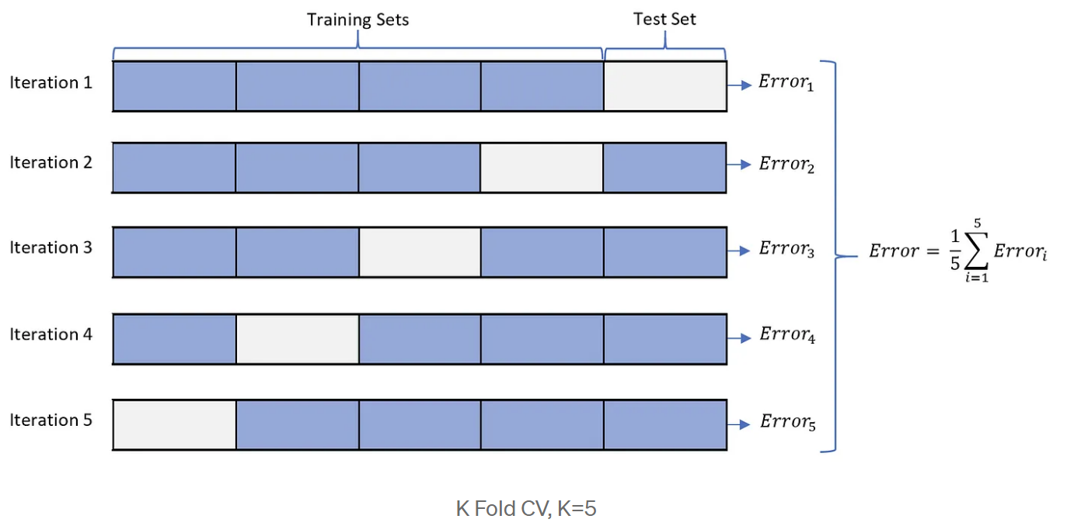
Important aspects to consider while constructing 1D-CNN model:
Specific layers, activation functions, and training parameters play an important role so need to treated carefully and experimented on.
Class imbalance between healthy and depressed subjects should be addressed.
It is necessary to employ cross-validation to ensure model resilience against overfitting.
Notes:
As a result of the research and in the light of these articles few things to consider while constructing the model:

Slide 22
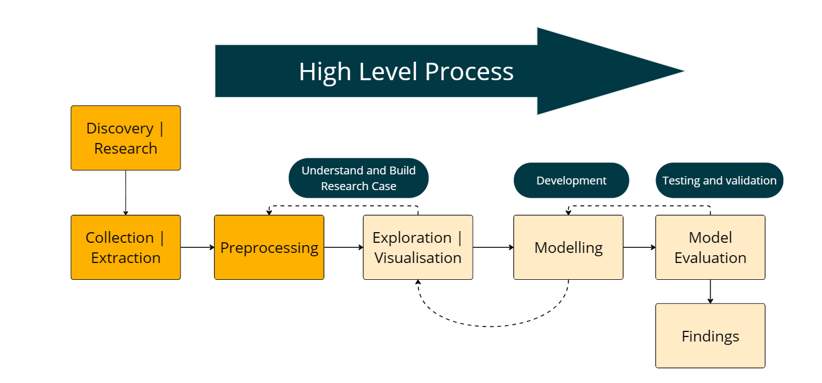
Our Models
Traditional ML models
(Deep dive into feature extraction and model )
Convolutional Neural Network (CNN)
( Building a more complex deep learning model)
Notes:
Tom: “Our team had two ideas which we decided to pursue for our model. Petter and myself worked on using a range of machine learning models and focused on feature extraction whereas Deniz decided to work on building a CNN model. Which she will talk through with you later on.

Slide 23
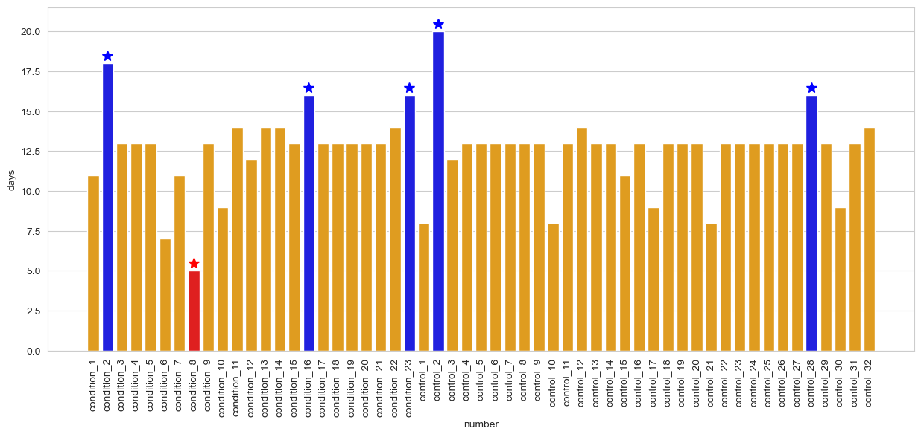
Traditional Model - Preprocessing
Used full true days [Garcia]
Reduced the data to full weeks
(Removed participant Condition_8 / Some participants had two weeks)
Split into Male / Female
Notes:
Tom: “For the traditional model approach, we decided to use true full days as used in the Garcia model to eliminate any spurious data and have an evenly spread set of values from each part of the day.
We decided to also reduce the dataset to full weeks so that we guaranteed a fair cross section of values from both weekdays and weekends. As one participant had less than 7 days’ worth of data they were removed from the dataset by this process. Additionally for participants that had more that 14 days' worth of logged time we decided to keep 2 weeks from them in order to retain as much data as possible.
Finally, the data was eventually split into male and female groups after features were extracted.
Time:
Total:
Team Member 2: “In our
TOM
TODO: bigger text, animated entry points
Time: 0:30 Minutes
Total: 3:30

Slide 24
Traditional Model – Features used
Garcia | Rodriguez
Mean | Kurtosis
Standard Deviation
Percent Zero
Notes:
Tom: “Some of the features we used came from papers that we had studied as mentioned previously such as mean, standard deviation, kurtosis and percentage of zero activity values. As mentioned, before we decided to summarise values at a day level rather than every hour as this would capture a much fairer cross section of activity.
Time:
Total:
Team Member 2: “In our
TOM
TODO: bigger text, animated entry points
Time: 0:30 Minutes
Total: 3:30

Slide 25
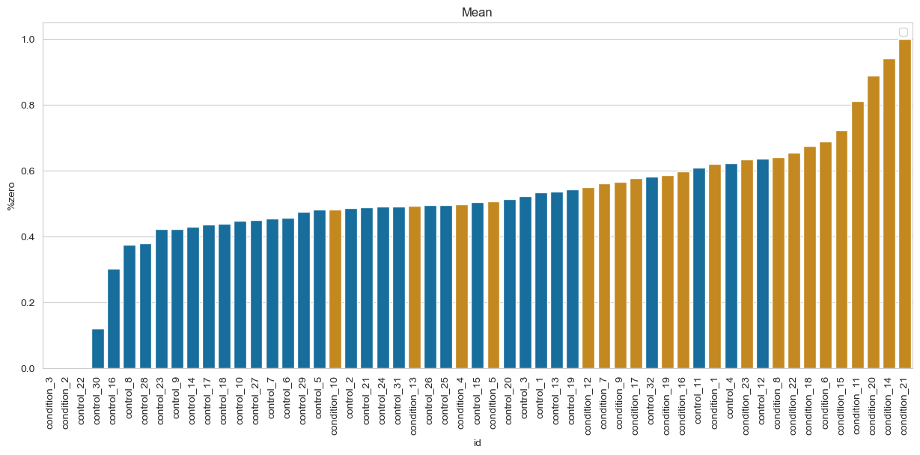
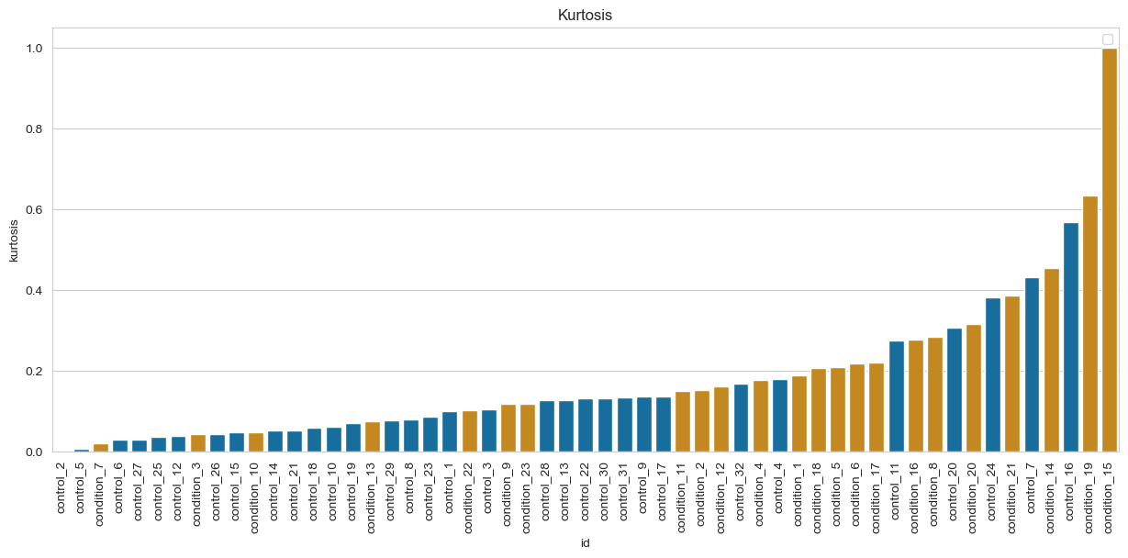

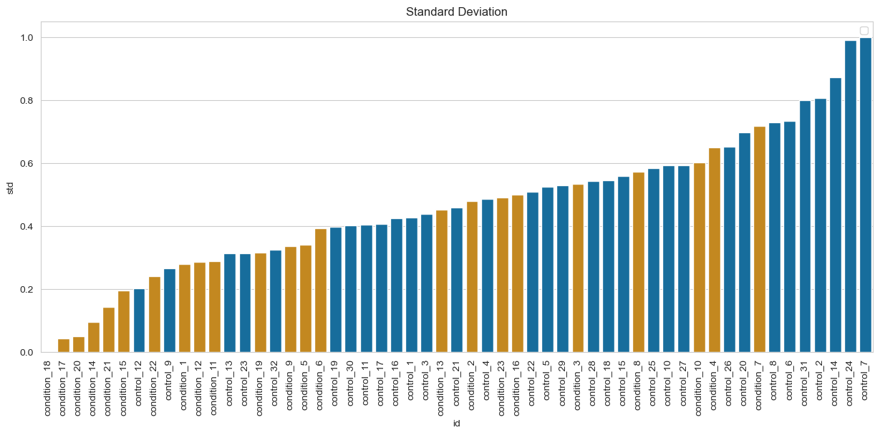
Traditional Model – Features used
Mean
Kurtosis
Percent Zero
Standard Deviation
Notes:
Tom: “When analysing these features, we saw that clusters of control and condition groups were created when these summary statistics were created as shown by these barplots.
Time:
Total:
Team Member 2: “In our
TOM
TODO: bigger text, animated entry points
Time: 0:30 Minutes
Total: 3:30

Slide 26
Traditional Model – Features used
Garcia | Rodriguez | Hu | Our own
Mean | Kurtosis | Awake / Sleep | Active / Inactive
Standard Deviation | Day Night |  | Dark / Light
Percent Zero |  |  | Percent Inactive during the day / light
 |  |  | Percent Active during the night / dark
Notes:
Tom: “We decided to explore further the use of features calculated from periods of day and night as explored in the Rodriguez model. We decided that instead of using arbitrary times research the dawn and dusk times in Norway at different times of the year and classified each period as being dark or light. We combined this with a sleep or inactivity classifier from the Hu model and created 4 further features. Percentage activity during nighttime, Percentage inactivity during daytime , Percentage activity while dark , Percentage inactivity while light.
Time:
Total:
Team Member 2: “In our
TOM
TODO: bigger text, animated entry points
Time: 0:30 Minutes
Total: 3:30

Slide 27
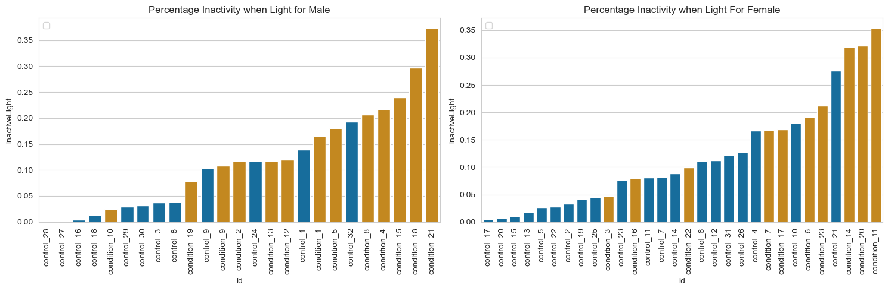
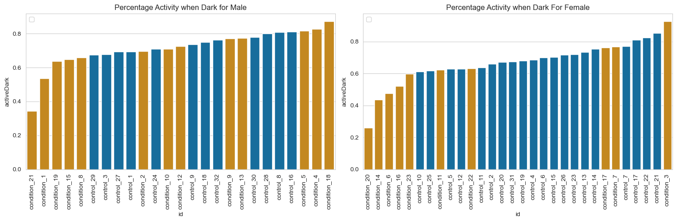
Traditional Model – Features used
Male
Female
Percent Inactivity when Light
Percent Activity when Dark
Notes:
Tom: “As you can see from these plots again data was clustered by depression state, so we thought that these to might be good features to test. We were aware that there will be some collinearity issues, so this was explored during the evaluation stage. Data was normalised but this was done after splitting to avoid data leakage.
Time:
Total:
Team Member 2: “In our
TOM
TODO: bigger text, animated entry points
Time: 0:30 Minutes
Total: 3:30

Slide 28
Models… traditional
Zero R Classifier
Random Forest
Linear SVC
Decision Tree
Logistic Regression
KNN
Naïve Bayes
Neural Network
XGBoost
LightGBM
AdaBoost
QDA
Gradient Boosting
SVM rbf
SVM linear
Gaussian Process
Accuracy
Precision
Recall
F1
Specificity
MCC
ROC_AUC
Elapsed Time
Models used
No hyperparameters
Measures used
Single / Cross-validation
Notes:
Time:
Total:
Team member: As per Garcia’s approach we fitted several models. We mostly stuck with the default parameters, except where we needed to increase a value to ensure model convergence, for example – so there was not hyperparameter tuning. Also as per Garcia, we captured several metrics so that we could get a full picture of the results. Models were fitted on a single run as well as with cross-validation, and we used a random seed to ensure repeatability.

Slide 29
Our findings…
Top models (Accuracy)
1. Both: QDA - 0.874
2. Male: QDA - 0.909
3. Female: LightGBM 0.879
Top models (Precision)
1. Both: AdaBoost - 0.867
2. Male: QDA - 0.88
3. Female: QDA 0.886
Top models (F1)
1. Both: QDA - 0.849
2. Male: QDA - 0.909
3. Female: LightGBM 0.825
Top models (Recall)
1. Both: QDA - 0.84
2. Male: QDA - 0.944
3. Female: LightGBM 0.81
QDA is good all-rounder
LightGBM good for female dataset
Improved MCC values
Top models (MCC)
1. Both: QDA - 0.742
2. Male: QDA - 0.819
3. Female: LightGBM 0.737
Top models (Elapsed Time)
1. Both: QDA - 0.03
2. Male: QDA - 0.027
3. Female: ZeroR 0.031
Notes:
Time:
Total:
Team Mate: We captured a significant amount of data. To summarise:
All the models performed very well out of the box. Quadratic Discriminant Analysis (QDA) is an all-round strong performer on each of the datasets.
LightGBM works particularly well for female dataset.
The MCC values are much better than those for the baseline models as well as others in the literature.
MCC – measures quality of binary classification – a balanced measure
0.7 and above is very good, 08 is excellent

Slide 30
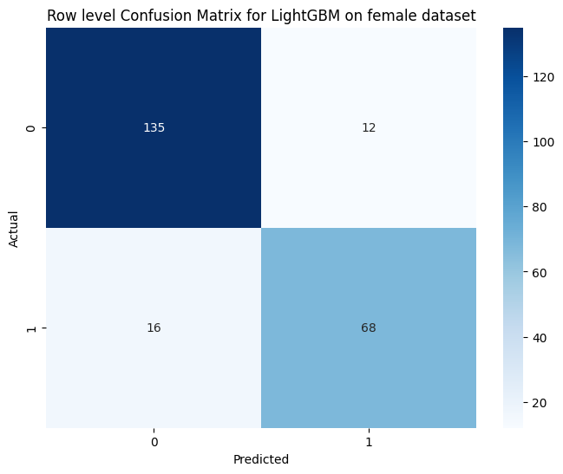
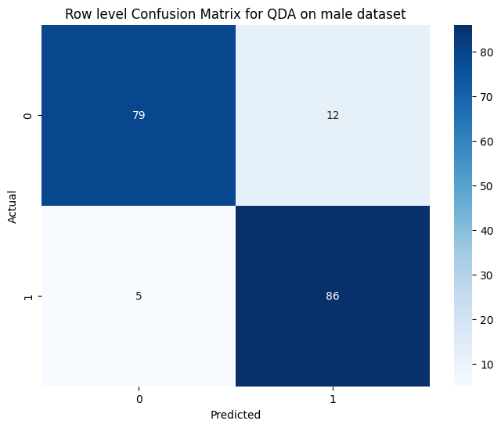
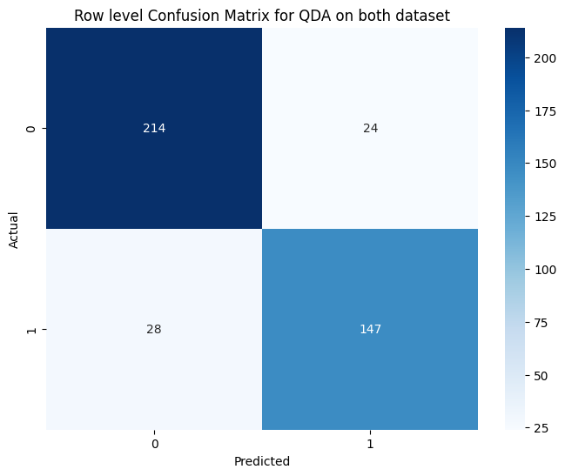
Aggregated Confusion Matrices from Cross Validation (folds = 5)
Our findings…
Notes:
Time:
Total:
Team Mate: Here we can see confusion matrices for each of the best performing models.

Slide 31
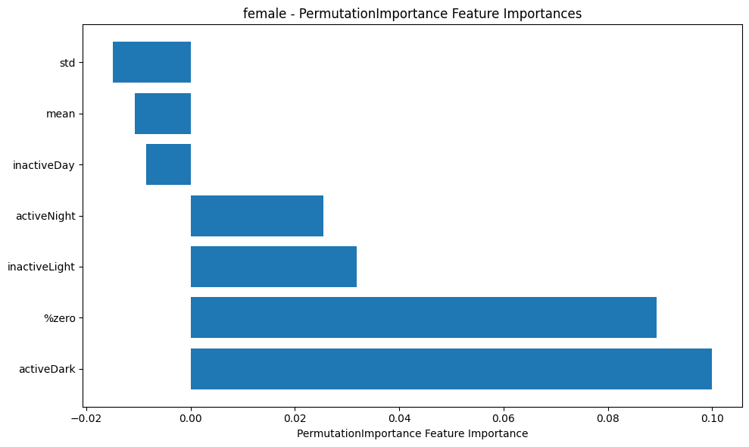
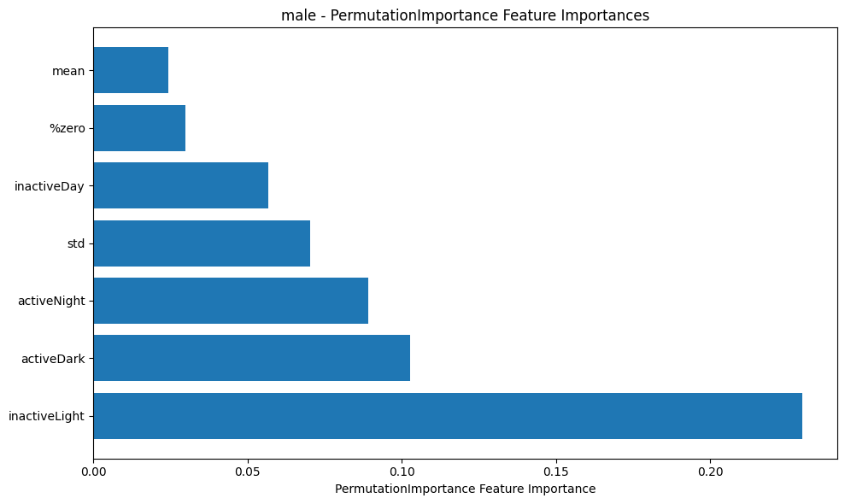
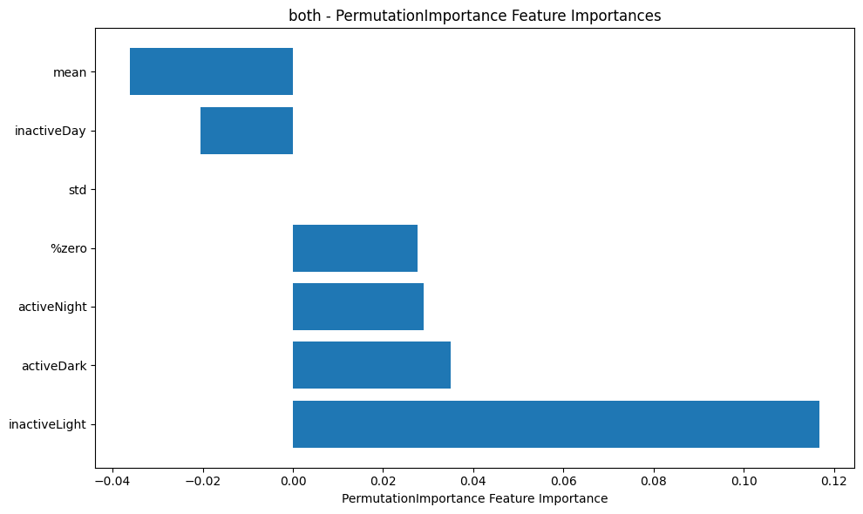
Selected Results – Permutation Importance
Female
ActiveDark, %zero are potentially strong features
Mean, std, InactiveDay may be unhelpful or unnecessary
Male
InActiveLight, ActiveDark are potentially strong features
Both
InactiveLight, ActiveDark are potentially strong features
Mean, InactiveDay may be unhelpful
Notes:
Time:
Total:
Team Mate: We also explored feature importance by a number of means including:
Random Forest - how much accuracy decreases if feature permuted
Decision Tree – how much feature contributes to Gini Impurity
Permutation Importance – negative values – if feature permuted, model improves (feature could be noisy or redundant); positive – permuting decreases model performance, therefore important
Variance Inflation Factors – values greater than 5 or 10 are problematic due to multicollinearity
We found that `Activity in Darkness` (restless, disrupted sleep) and `Inactivity in Light conditions` (not moving much during the day) are very important features, with some nuance between the Male and Female datasets. For Females, ActiveDark and for Males InActiveLight were the most important features.

Slide 32
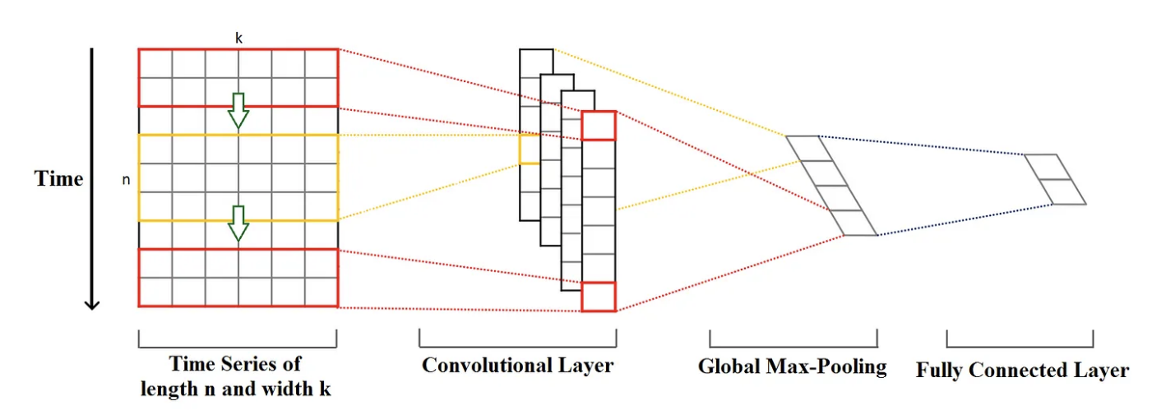
Convolutional Neural Network (CNN)
1-D Convolution for Time Series.
Layer types
Pooling dropout
Other parameters
Y. Kim, Convolutional Neural Networks for Sentence Classification (2014), https://arxiv.org/abs/1408.5882.
Notes:
Time: 2:00 Minutes
Total: 9:00
CNN is a deep learning algorithm that is mostly utilized for image processing. We'll focus more on the time series usage of CNN and discover why it would be an useful approach in our case. Briefly the figure shows a time series of length n and width k. The length is the number of timesteps, and the width is the number of variables in a multivariate time series. In our case variables are feature such as activity gender etc.

Slide 33
Why use CNN on Depresjon dataset?​
​
CNNs are able to extract valuable features from sequential motor activity data in an efficient manner, similar to how they can extract features from images' spatial information.​
​

Slide 34
Problems encountered - How to overcome them
Data leakage resulting from splitting the data into training and test sets after normalization.
Future improvements
Data augmentation techniques such as generating new variations of existing data (adding noise, shifting time windows).

Slide 35
Our Reflections
Daryne Bouadi: I aim to build a better understanding in analysing and interpreting data as well as leaning more about machine learning and big data.
Deniz Turan: My primary objective is to deepen my understanding of various machine learning algorithms and explore the deep learning models in general. Additionally, I aim to sharpen my skills in collaborating with a team, with a goal of successfully delivering end-to-end project.
Petter Lövehagen: My mission is to fully engage with the team, contributing to our collective growth in machine learning competency and professional collaboration abilities. I look forward to learning from my peers and tutors to advance my own skills, knowledge, and ways of working, as well as producing high-quality deliverables.
Tom Grubb: I felt that I learnt a lot during this project, I improved my use of python, researching skills and Github. I enjoyed working with Petter on our model more so than trying to project manage the group. I was surprised by the lack of rigor in a lot of the published work and had it not been for a timely conversation with my machine learning lecturer may have made similar mistakes myself
Yacine Ramdani: My mission is to absorb knowledge and hone my skills across various machine learning technologies, preparing myself to seamlessly apply them in real-world contexts.
Notes:
Time: 1:00 Minute (10 seconds each)
Total: 1:30
Team Member4: “Before we started the project we set out some personal goals for ourselves that we included in our project proposal. As we introduce ourselves to you we will also go through briefly what we wanted to gain from the project”
Daryne: “Hello I am Daryne …
Deniz:
Petter:
Tom : “I felt that I learnt a lot in during this project, I improved my use of python, researching skills and Github. I enjoyed working with Petter on our model more so than trying to project manage the group. I was surprised by the lack of rigor in a lot of the published work and had it not been for a timely conversation with my machine learning lecturer may have made similar mistakes myself.”
Yacine:

Slide 36
Thank You Any Questions?
GitHub Repository:
https://github.com/zoonalink/IGP-5

